Slide 1

World Happiness Analysis
Rahul Gade
Dominik Foale
Ishika Kharola
Priyanshu Rana

Slide 2
Project Scope
We aim to analyse the happiness score/index of each country and its correlation with various socio-economic indicators.
GDP
infant mortality
Life expectancy
minimum wages
out of pocket health expenses
Physicians per thousand people
population
unemployment rate
social support
Freedom to make life choices
Generosity
perception of corruption

Slide 3
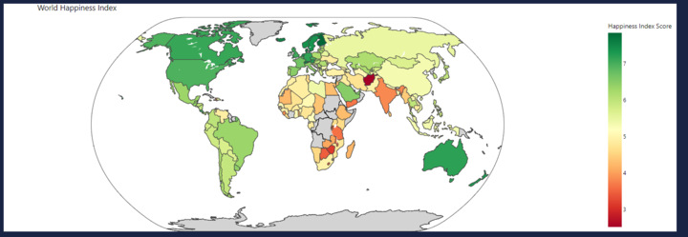
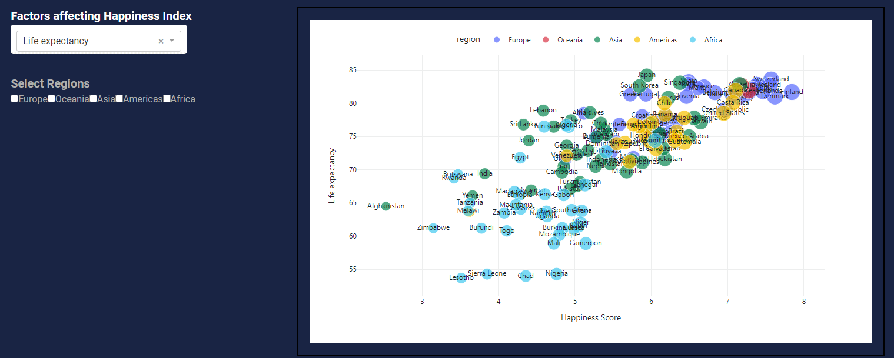
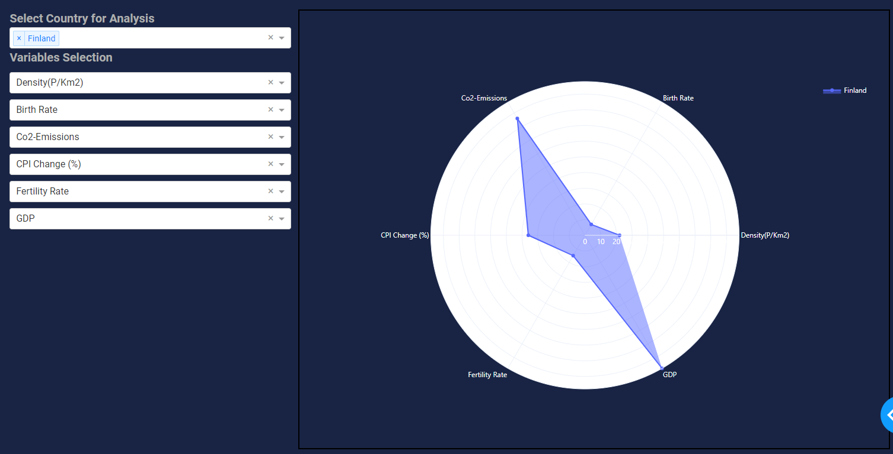
Choropleth Geo Map
Scatter Plot
Radar Chart

Slide 4
World Happiness Index & Global Data
Datasets:
https://www.kaggle.com/datasets/nelgiriyewithana/countries-of-the-world-2023
https://www.kaggle.com/datasets/ajaypalsinghlo/world-happiness-report-2021
https://www.kaggle.com/datasets/andradaolteanu/country-mapping-iso-continent-region
Database Diagram: QuickDBD
Database: Postgres SQL
Visualizations:
Geomap: Choropleth Geo map
Scatter plot: Plotly Dash library
Radar chart: Plotly Dash library

Slide 5
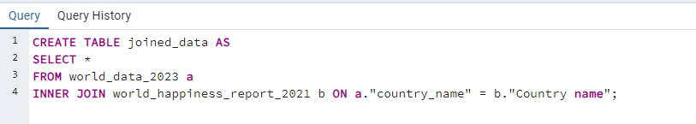
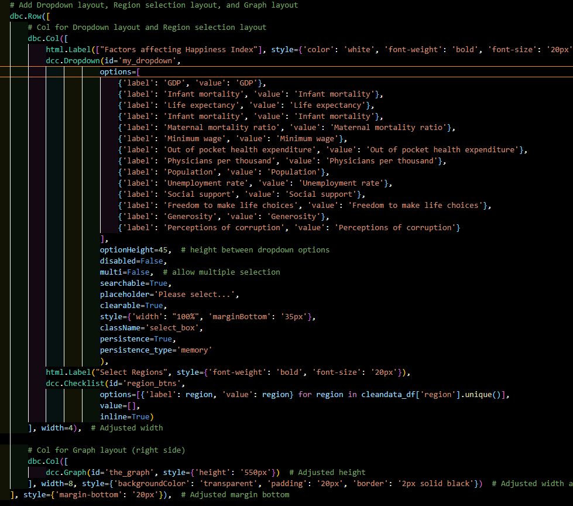


Data Preparation
Code
SQL Query used to join data
Python Query to rename columns/columns kept

Slide 6
Ethical Considerations
Privacy
Does the data breach the privacy of individuals?
Subjectivity
Does the data account for the subjectivity of happiness?
Bias/Representativeness
Is the data accurate and not misleading?

Slide 7
Conclusion
Strongest determinants of high happiness scores:
Social Support
Freedom to make life choices

